Slide 1

Cheese & Wine Pairing Recommender (NLP and Unsupervised ML)
Basak BULUTTEKIN
Ironhack Paris – Data Analytics
June 2023

Slide 2
Agenda
Project Description & Planning
Data Collection & Data Cleaning
EDA
ERD & MYSQL
Machine Learning
Demo
Challenges
Conclusion

Slide 3
Description & Objective
The goal of the wine-cheese pairing recommender project is to create a user-friendly tool that helps people discover the perfect combinations of wine and cheese.
The project intends to offer recommendations based on the taste description and variety type of wine.
Aim is to simplify the pairing process for everyone.

Slide 4
Wayforward Plan of The Project
Searching for data on the internet
Loading data from csv into Python
Web-scrapping to acquire additional data
Cleaning and reorganizing the data in Python
Performing exploratory data analysis and visualization
Sending the clean data to create MYSQL database
Analyzing data in MYSQL using various queries
Building Machine Learning model incorporating NLP techniques

Slide 5
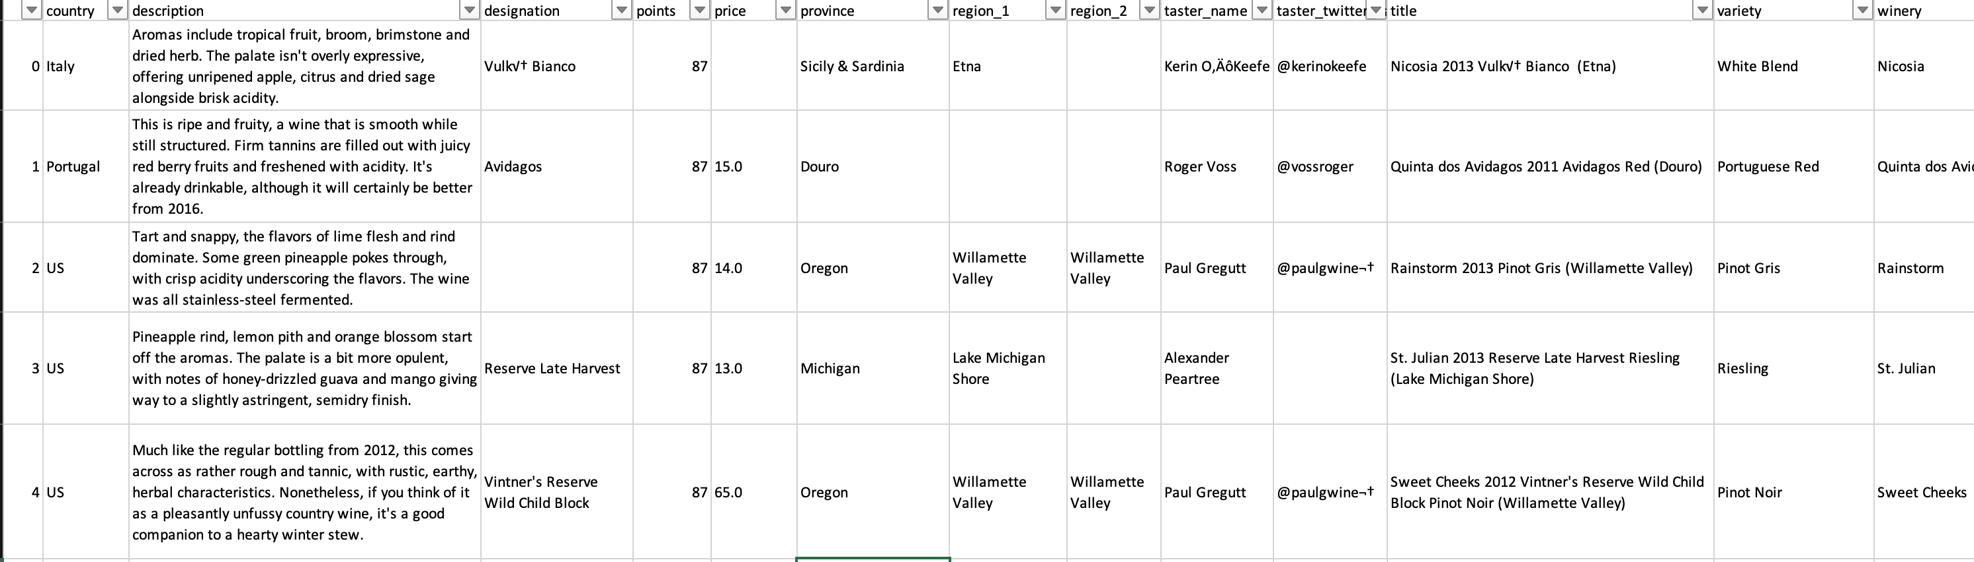
Data Collection
Wine Dataset Collection
Webpages – Web Scrapping
https://www.ventealapropriete.com
https://www.vivino.com
https://www.1jour1vin.com/fr
Kaggle – Wine Reviews (CSV)
https://www.kaggle.com/datasets/zynicide/wine-reviews
130K row
13 columns
Wine & Cheese Pairing Dataset
(Manually created – 29 different cheese)
Webpages:
https://winefolly.com/wine-pairing/12-classic-wine-and-cheese-pairings-you-have-to-try
https://www.seriouseats.com/guide-to-best-wine-for-cheese-pairing-cheat-sheet-party-cheese-plate-wine-advice
Pairing: cheese types were paired the wines who have high rating in the dataset.

Slide 6
Data Cleaning
NaN Values
Replacing with “Other” & “Unknown” → “Country”, “Province”, “Region” columns
Dropping → “Variety”, “Year”
KNN imputation → “Price_USD”
Duplicated
“Wine_name” → Has to be unique
Outliers
Checking and keeping as they are → “Price_USD” and “Points” (Review Ratings)
Adding New Column(s)
Year → Split from “Wine_Name”
Make-up
Renaming columns, deleting extra whitespaces in “Wine_Name” column

Slide 7
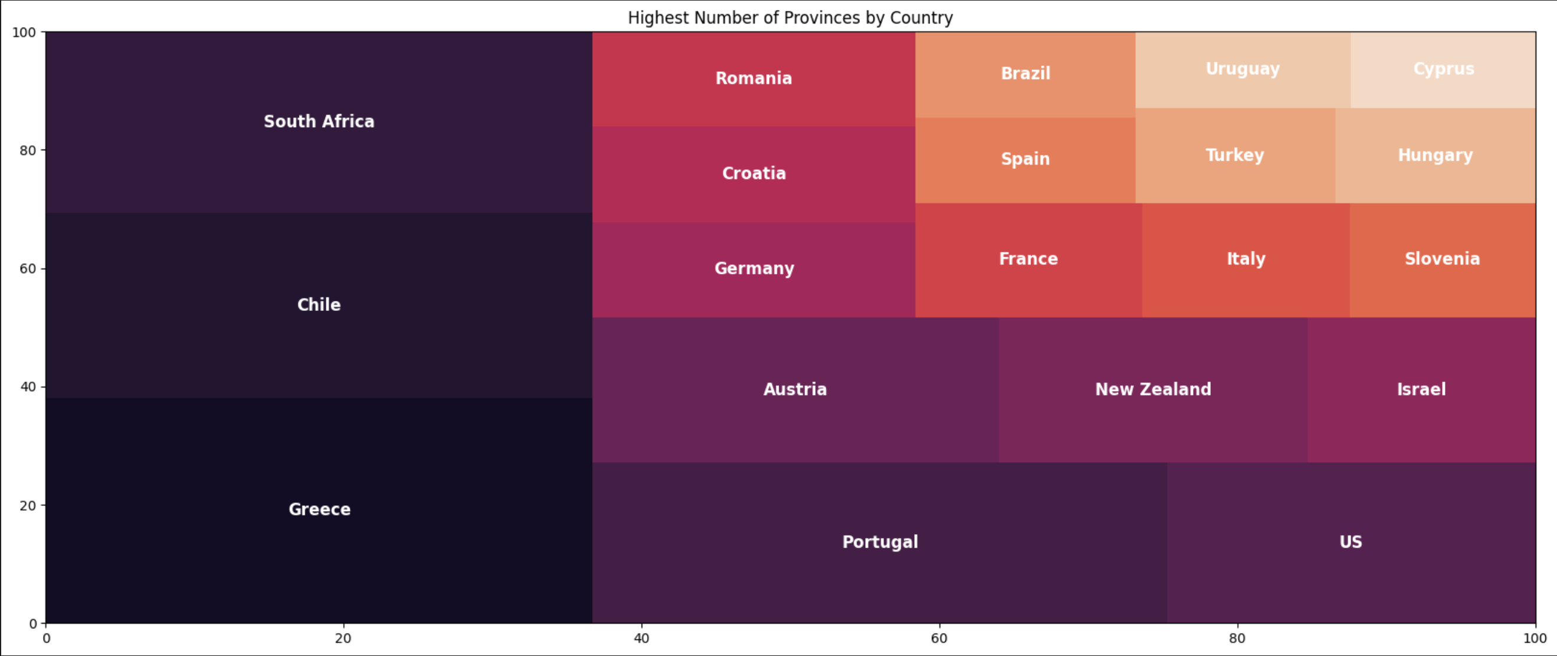
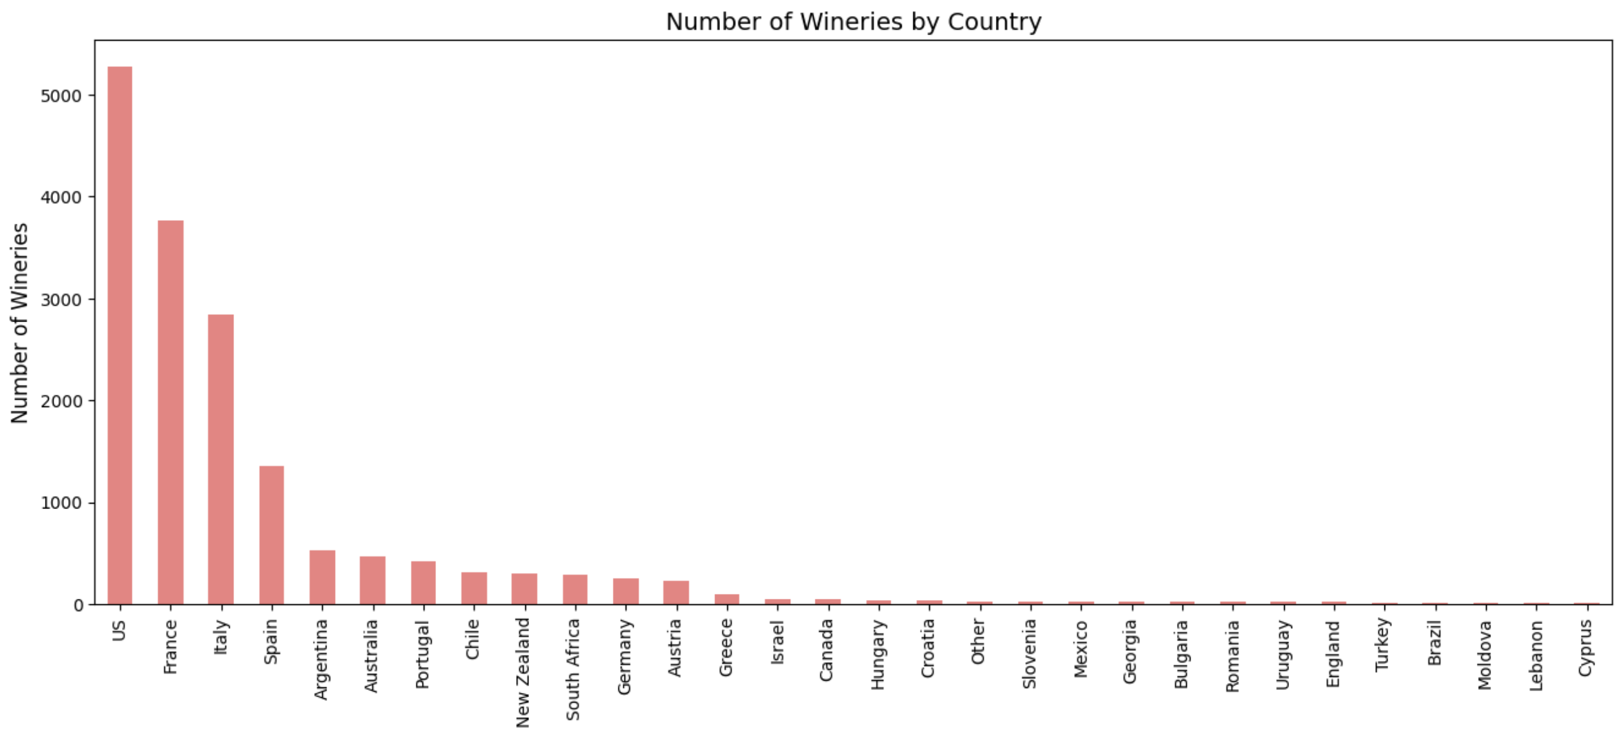
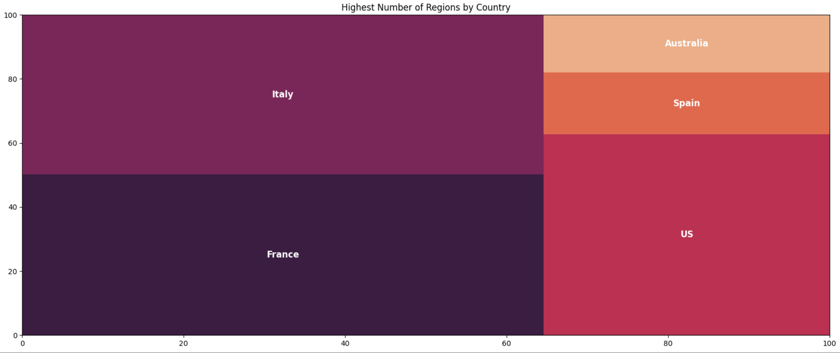
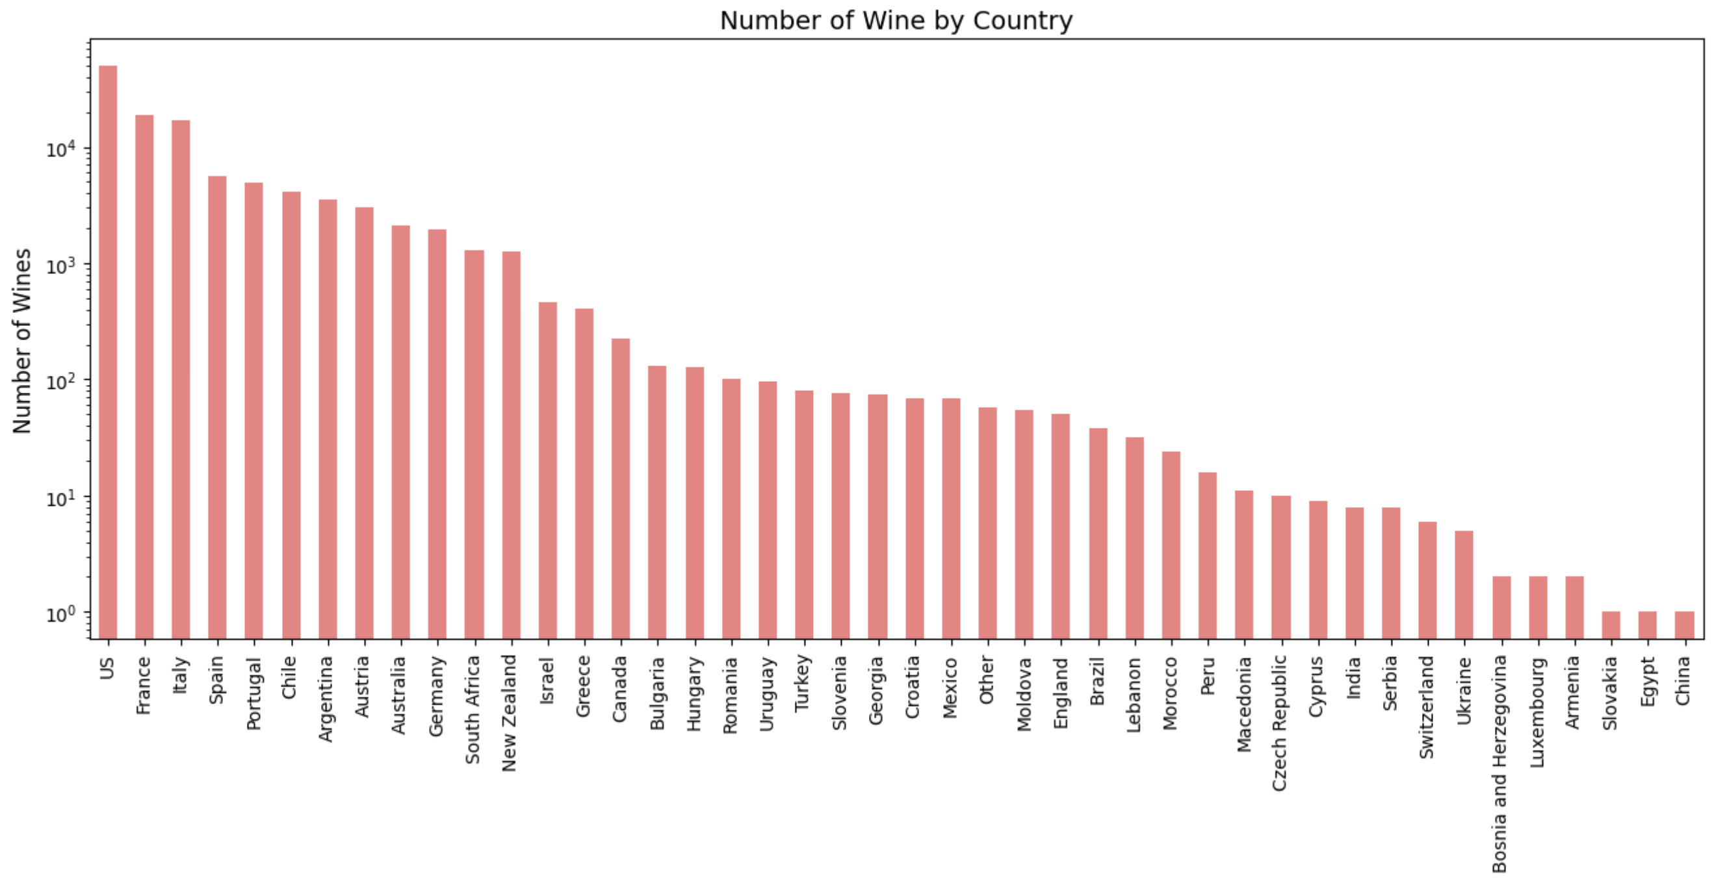
EDA & Visualization

Slide 8
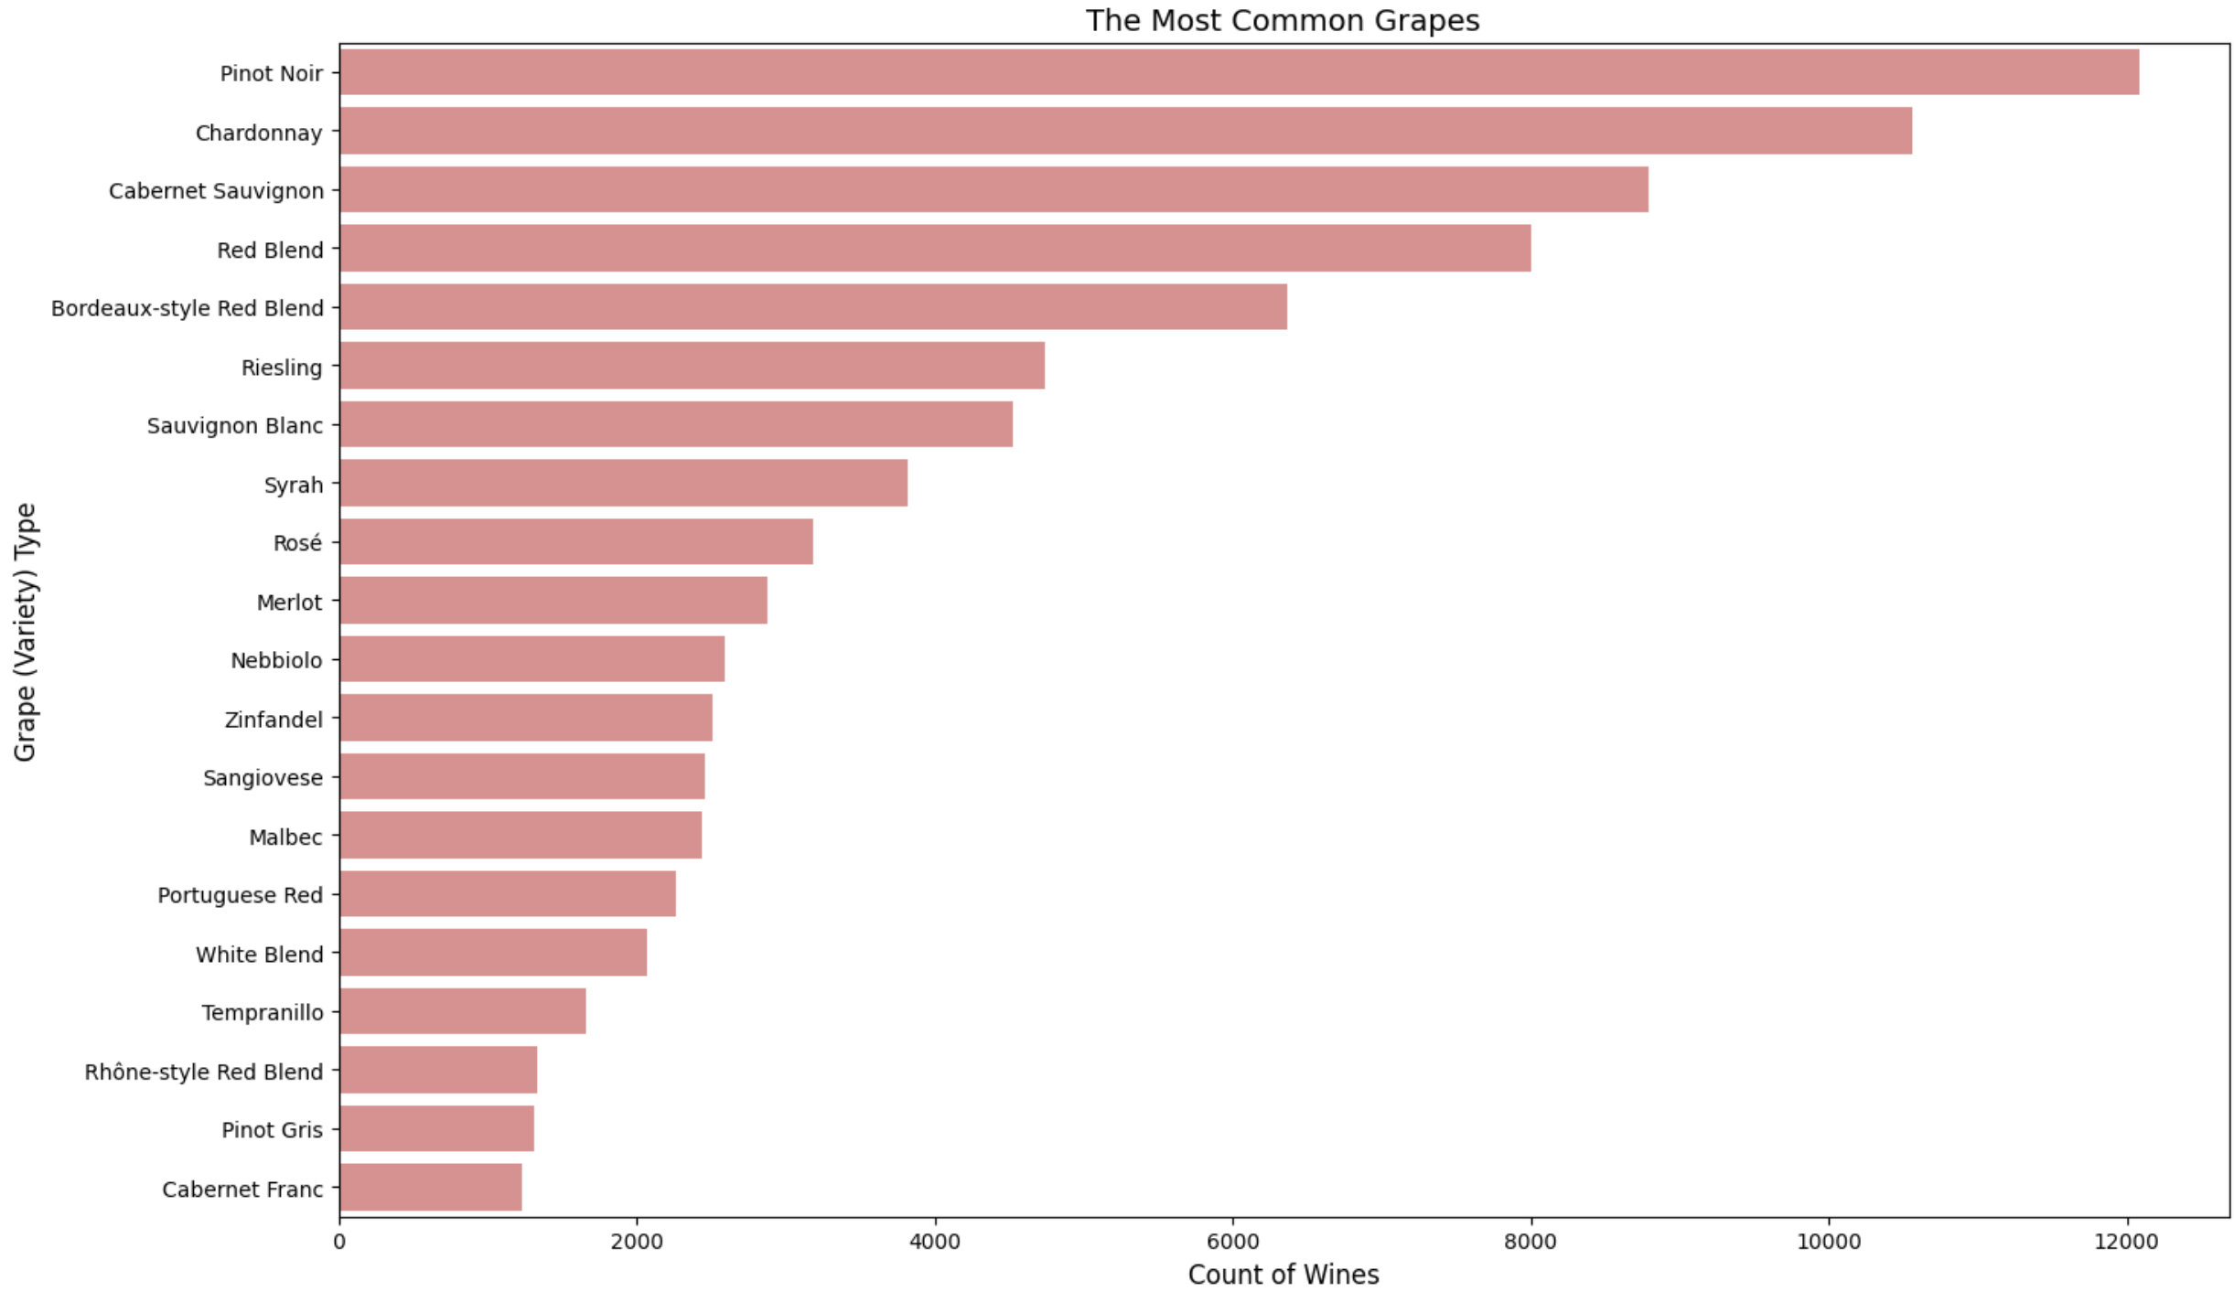

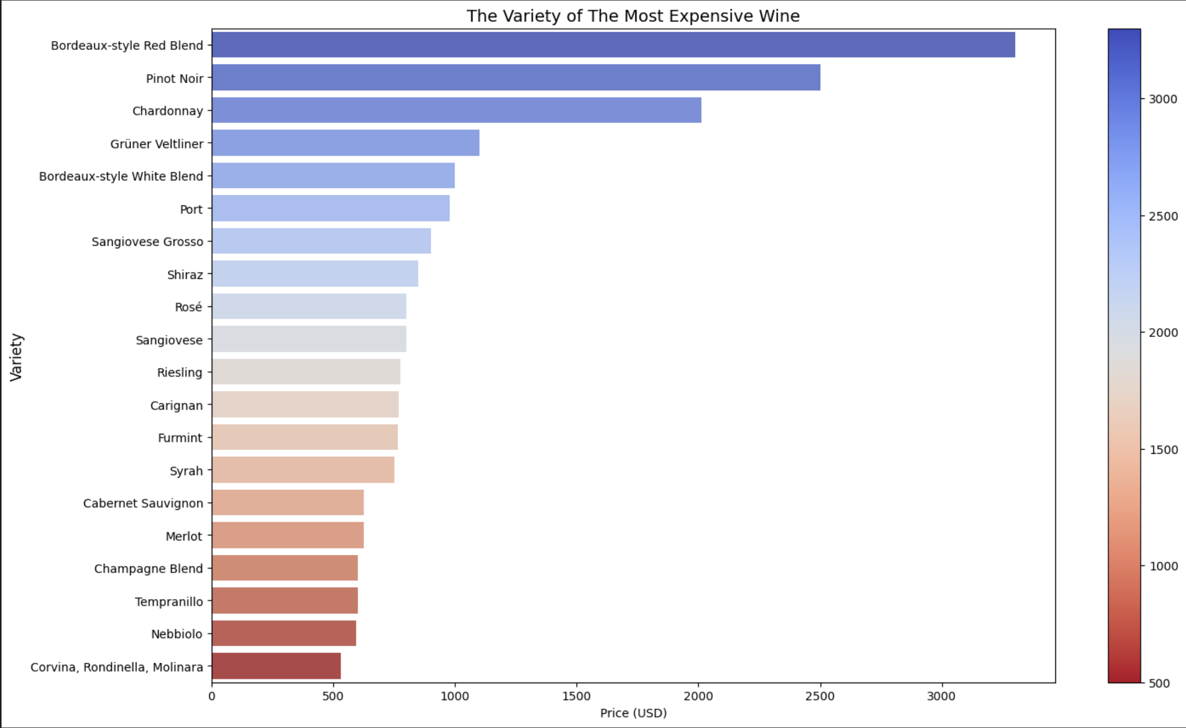
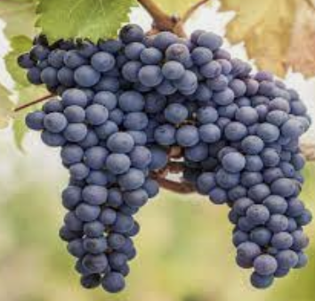
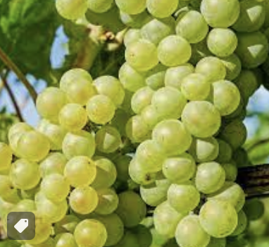
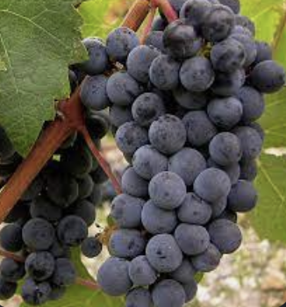
EDA & Visualization
Secret of Bordeaux Style Red Blend : Cabernet Sauvignon, Merlot, Cabernet Franc, Petit Verdot, and to a lesser extent Carmenère and Malbec.
Total variety = 700

Slide 9
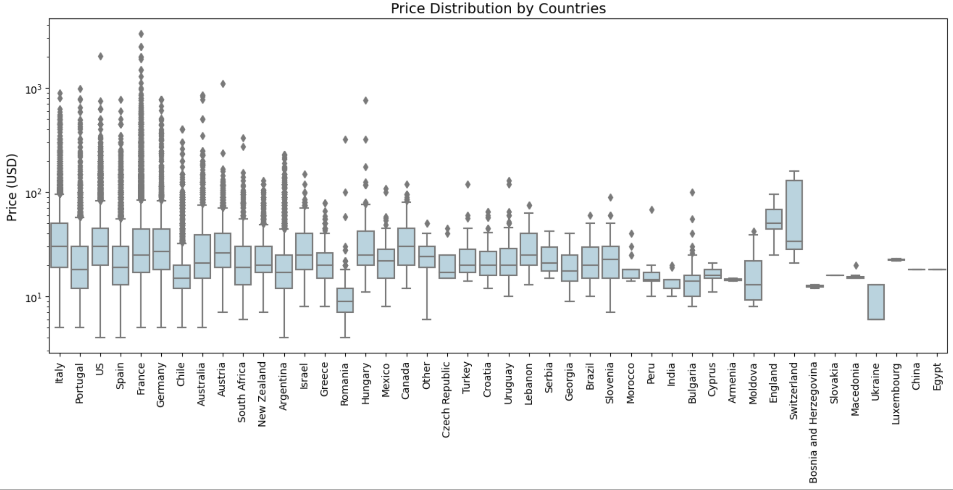
EDA & Visualization

Slide 10
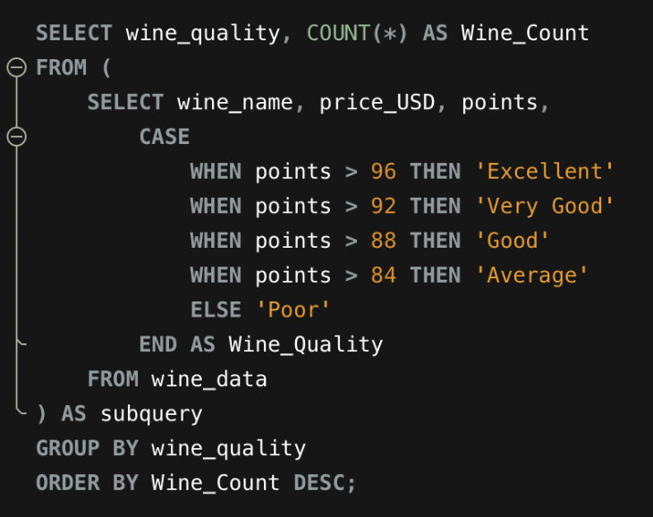
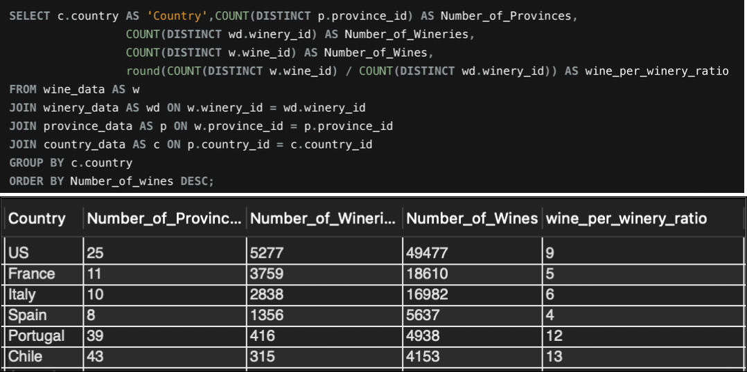
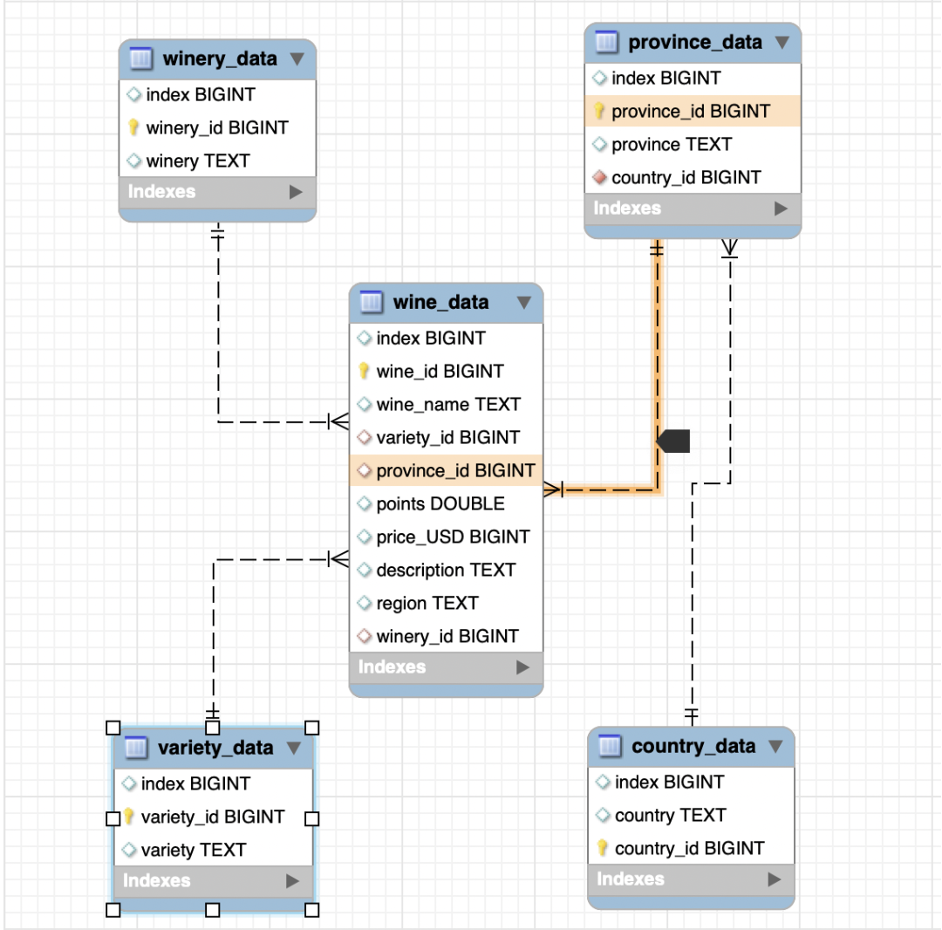
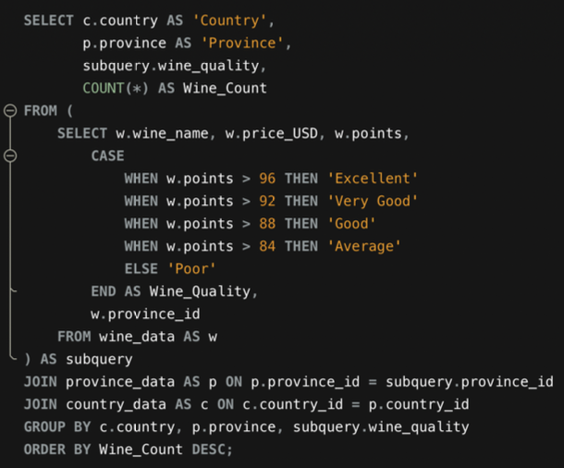
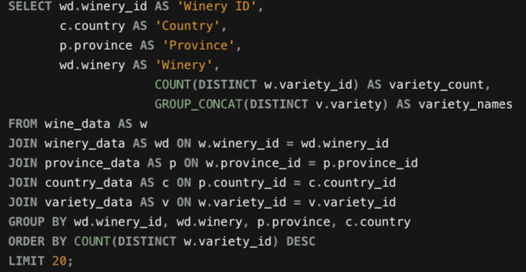
ERD & MYSQL Queries

Slide 11
Highlights of EDA
Global Dominance: A staggering 80% of the wines in the dataset originate from just five countries: United States, France, Italy, Spain, and Portugal.
Province vs. Region and Winery: While province information shows no significant correlation with other variables, the variables of region and winery exhibit strong associations with the wine's variety and production.
French Elegance: The most expensive wines predominantly hail from European countries, with France taking the lead. French wines, renowned for their exceptional quality, command higher prices in the market.
Price Spectrum: The average price of wines in the dataset hovers around $35 per bottle. However, notable outliers exist, representing wines at significantly higher price points.
Diverse Variety: With approximately 500 distinct wine varieties in the dataset, developing detailed descriptions for each one becomes paramount for building an effective recommender system.
Grape Distribution: Examining the distribution of the top 15 most common grape varieties reveals a substantial prevalence, providing a crucial foundation for constructing a comprehensive cheese pairing dataset.
Winery Practices: US wineries demonstrate a propensity for producing wines with varied characteristics under the same winery label. In contrast, European wineries tend to maintain a narrower focus on specific wine profiles.

Slide 12
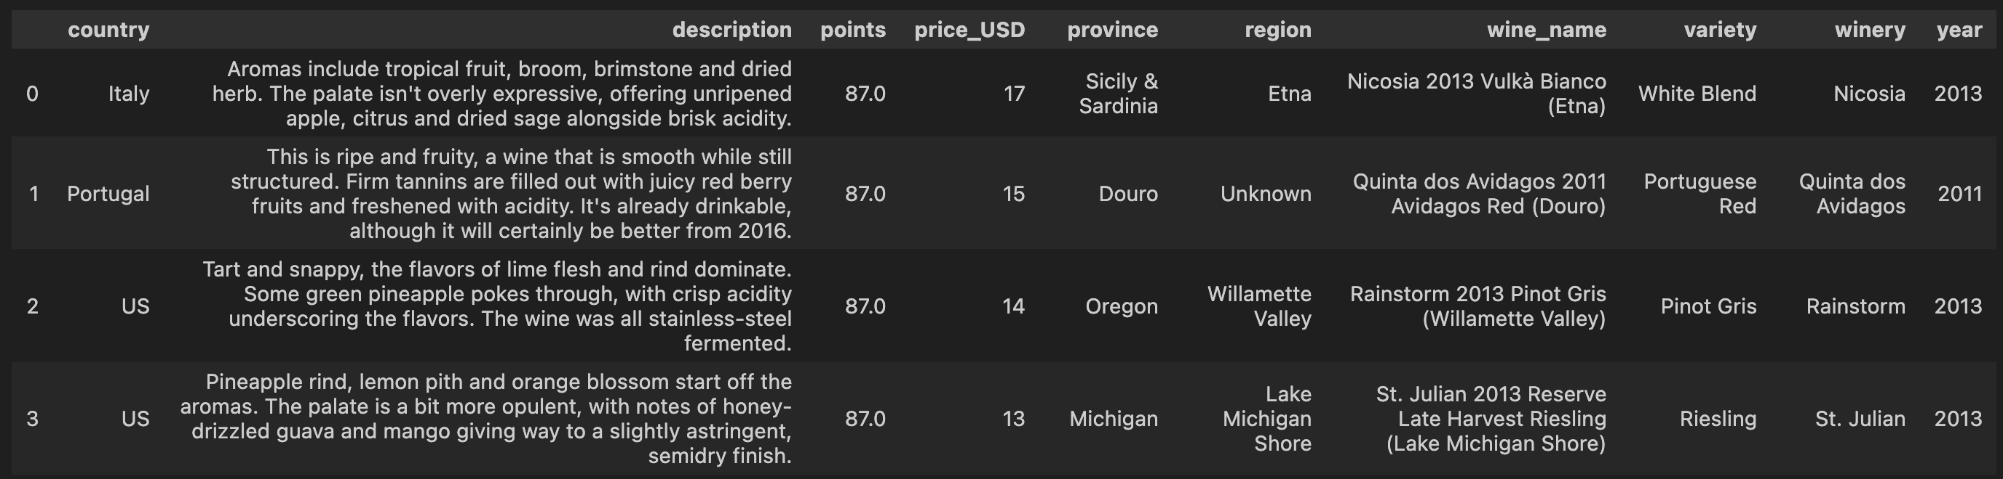
Machine Learning Model
Count Vectorizer()
Normalizer() & Scaler()
Concatenate()
NearestNeighbor()
Results
TruncatedSVD()
hstack
From text to matrix
Decrease the dimension
n_components = 10
default=’randomized’
Variance ratio = 25%
Stack sparse matrices horizontally (column wise)
Normalizer
Standard_Scaler for numerical columns
Algorithm = ‘Brute’ proper for big dataset
n_neighbors = 6
kneighbors(): distances; indices

Slide 13
Machine Learning Model Improvement
Count Vectorizer()
OneHotEncoder
Normalizer() & Scaler()
Concatenate()
NearestNeighbor()
Results
TruncatedSVD()
hstack
From text to matrix
Decrease the dimension
n_components = 10
default=’randomized’
Variance ratio = 25%
Stack sparse matrices horizontally (column wise)
Normalizer
Standard_Scaler for numerical columns
Algorithm = ‘Brute’ proper for big dataset
n_neighbors = 6
kneighbors(): distances; indices
More weight was given to “variety” based on the manual check

Slide 14
Machine Learning Model Highlights
During the first run of the ML algorithm, the following features were vectorized: "description", "variety", and numerical data such as "points", "price_USD", and "year".
In the second run of the ML algorithm, the following features were vectorized: "description", "variety", encoded "country", encoded "region", and numerical data such as "points", "price_USD", and "year". However, it was observed that without the inclusion of country and region information, the algorithm didn't perform well and provided irrelevant recommendations.
In the third run of the ML algorithm, the following features were vectorized: "description", "variety", encoded "country", encoded "region", and numerical data such as "points". Also weight of ”variety” was multiply with 3 because the main parameter of pairing is based on the type of grape.
The inclusion of country and region information improved the relevance of the recommendations.
Additionally, it was found that including the "year" feature restricted the algorithm and led to irrelevant recommendations.
Interestingly, the inclusion of "price_USD" information didn't significantly impact the results.

Slide 15
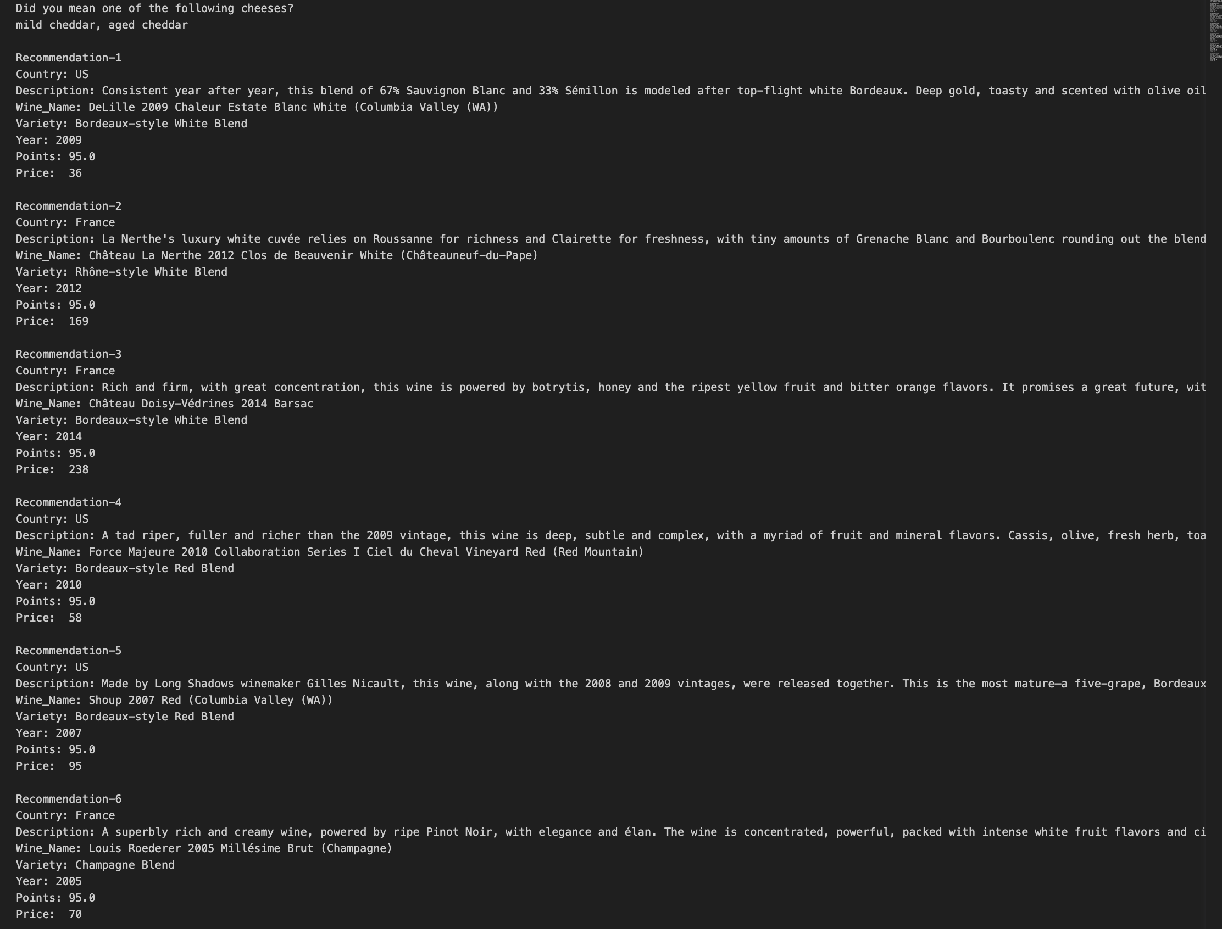
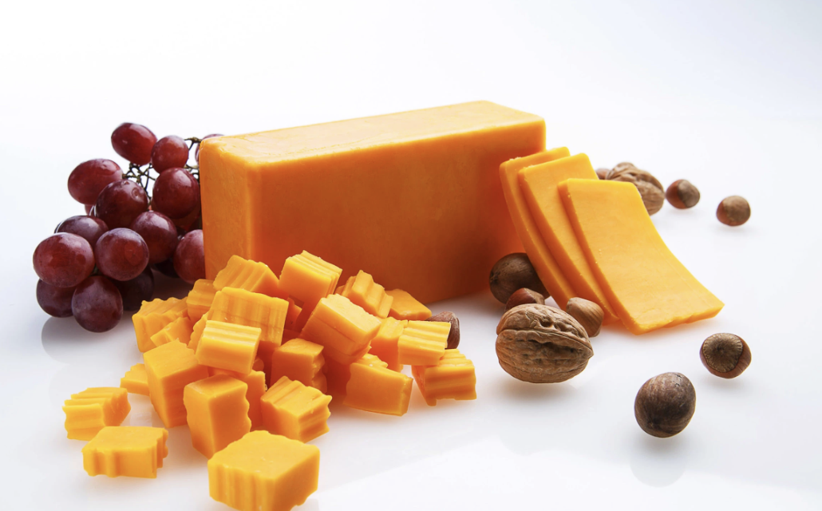
Results of ML Model
Mild Cheddar

Slide 16
DEMO

Slide 17
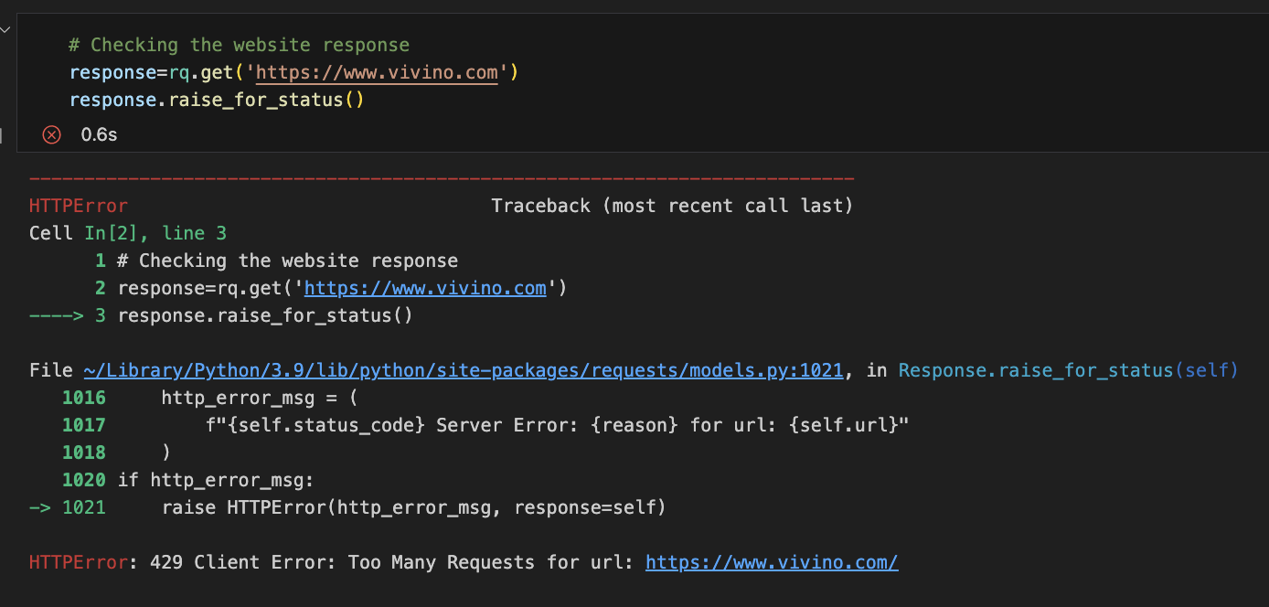
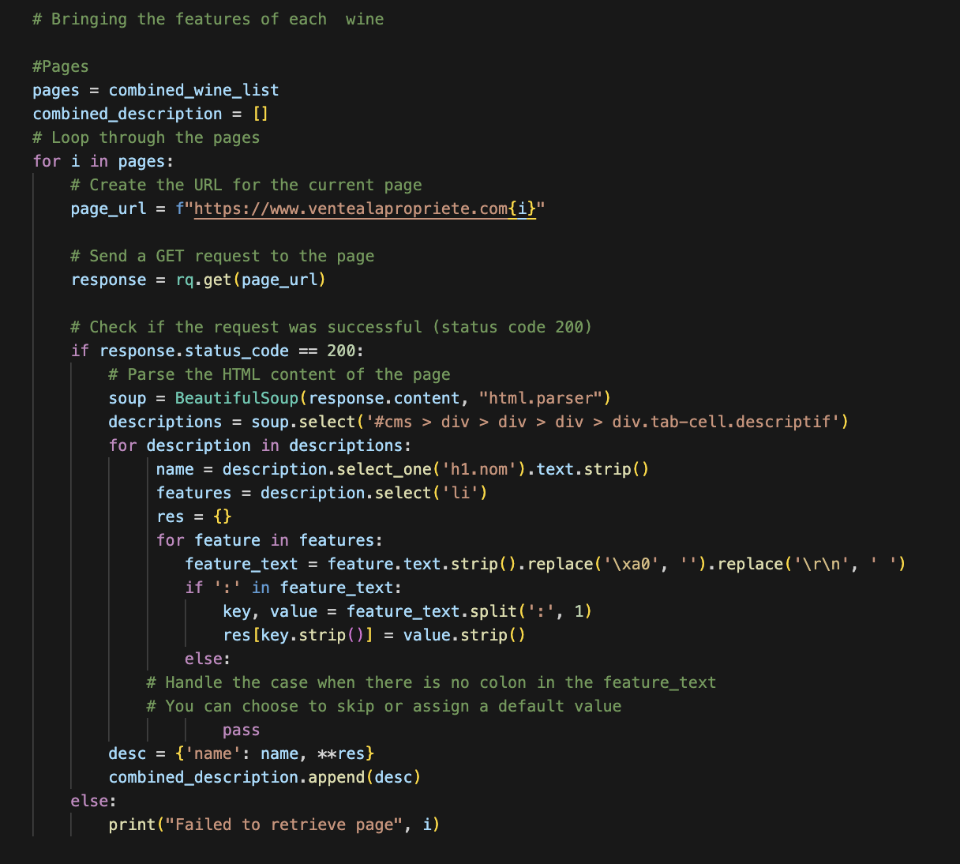


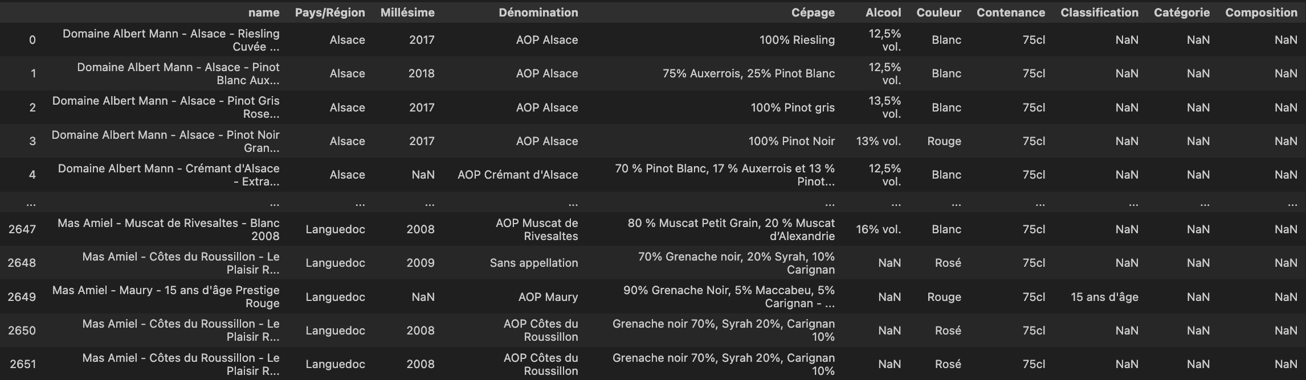

Challenges

Slide 18
Conclusions
Dataset selection is crucial: The right dataset is essential for building an effective recommender system.
Data cleaning is the key: Proper data cleaning ensures the quality and accuracy of recommendations.
Validate outputs: Carefully examine and validate the recommendations generated by the algorithm especially if the algorithm is unsupervised.
Diversity matters: A diverse dataset leads to more robust and relevant recommendations.
Improvement: There is always better version and of course the tool can be improved much more further.
Cheese as an inspiration: The love for cheese provides a delightful reason to explore and enjoy the perfect bottle of wine.
Remember, a great recommender system requires thoughtful dataset selection, meticulous data cleaning, and a passion for discovering perfect wine and cheese pairings.

